Slide 1
Dijkstra shortest path algorithm
Adam, Luke, Sam

Slide 2
What is Dijkstra’s shortest path algorithm?
Dijkstra’s shortest path algorithm calculates the shortest distance between two nodes on a graph.
The algorithm was devised by a Dutch computer scientist called Edsger Dijkstra and published in 1959.

Slide 3
How does it work?
Dijkstra’s algorithm works by working out the shortest path between a single starting vertex and every other vertex on the graph. As a result, it also produces the shortest path between the starting vertex and a destination vertex. However, this only works on weighted graphs with positive values on edges.
In this example, the red dot is the starting vertex and the green dot is the destination. As you can see, the algorithm works through every node until it finally reaches the destination, hence discovering the shortest path.

Slide 4
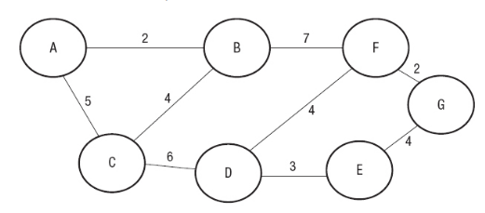
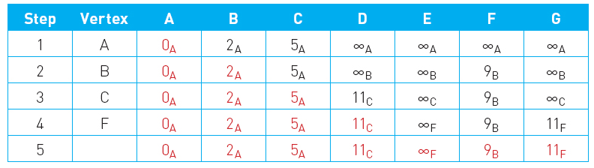
Dry run

